Slide 1

SATELLITE ANTENNA
TRACKING SYSTEM
ECEN 403-902
Sponsor: David Gent
TA: Pranav Dhulipala
Team: David Santos, Michael Raabe, Hunter Britton
Photo from Pexels.com by @InstaWalli

Slide 2
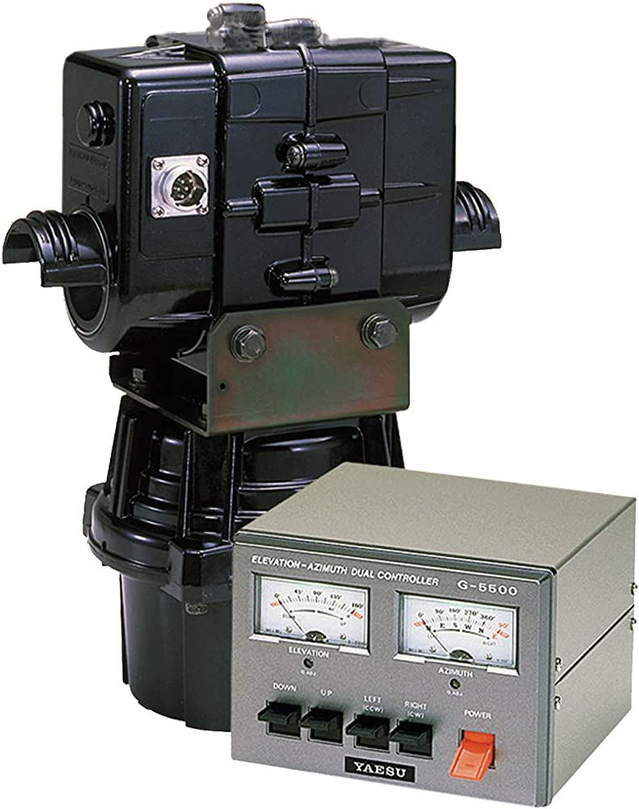
Executive Summary
Problem Statement
Amateur radio enthusiast need remote access
Current systems use outdated proprietary software/expensive hardware
Our Solution
Additional Hardware + Web Interface
Flexible, Collaborative, and Inexpensive
Yaesu G-5500 Rotator
Source: Amazon.com

Slide 3
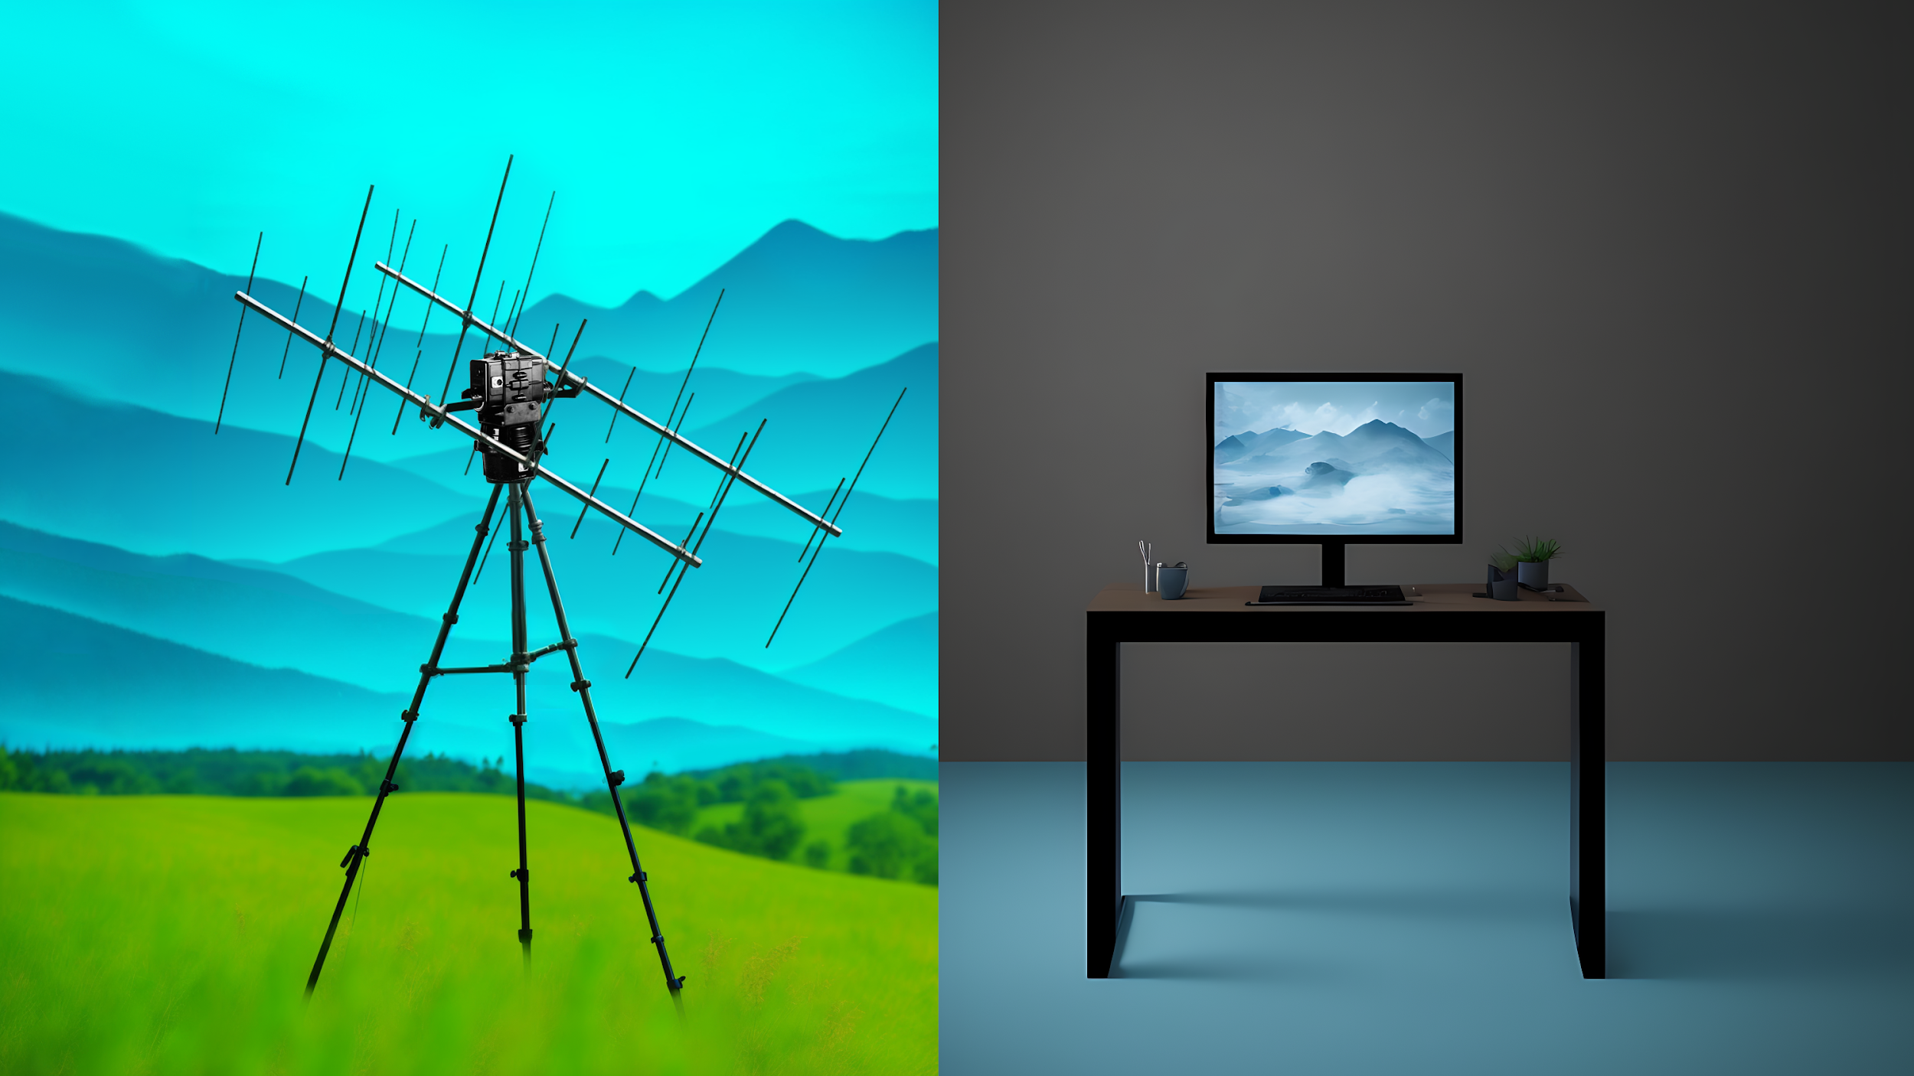

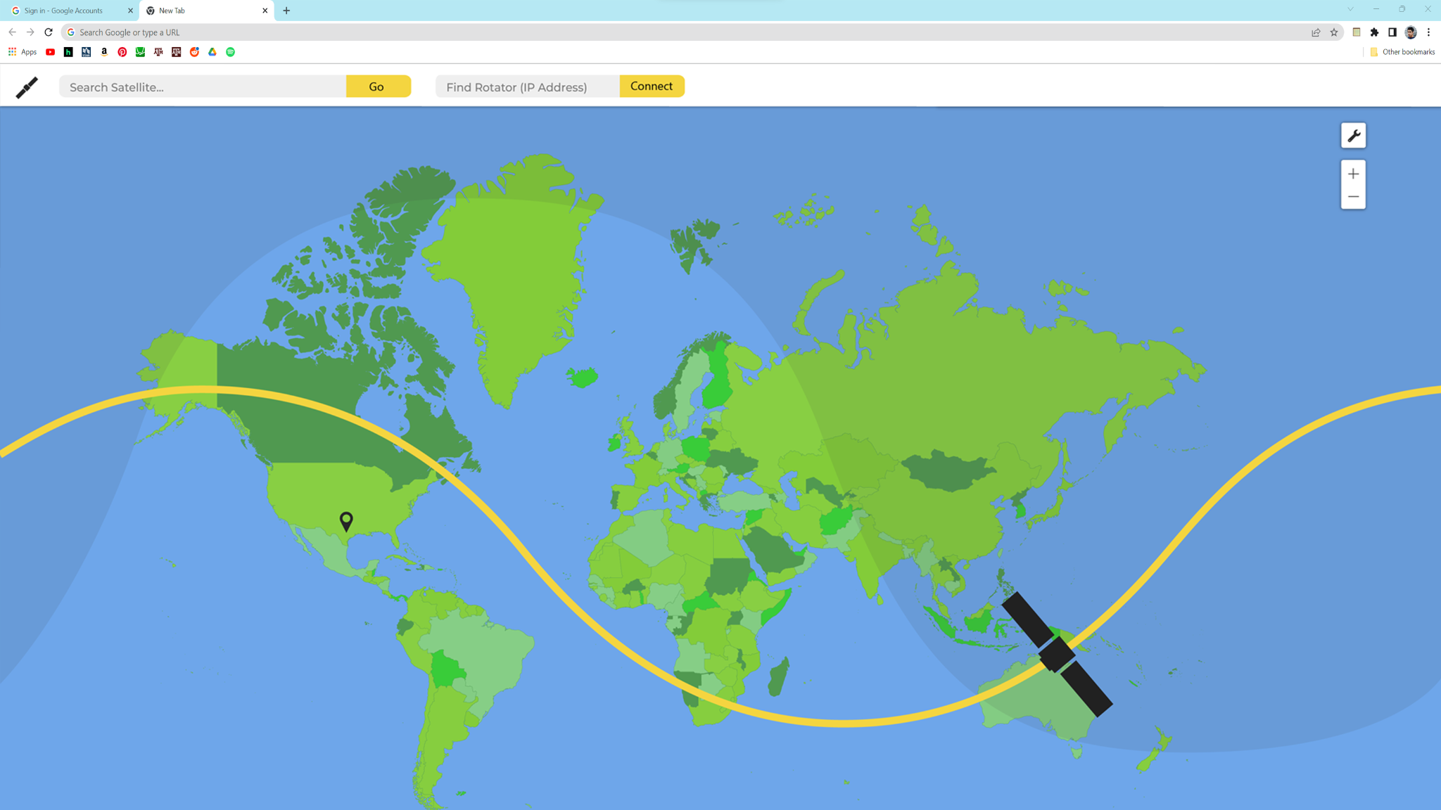
Cloud Platform
Photo generated with Stable Diffusion

Slide 4
System Overview
SDR
Web App
UI Components
Firebase
MCU Port
Antenna Array
Rotator
Custom PCB
Microcontroller/IO
Elevation Motor
Motor Driver
Display
Wifi
Azimuth
Motor
PSU
MCU
GPS
Legacy
Michael Raabe
Hunter Britton
David Santos

Slide 5
Microcontroller - Hunter Britton
MCU/IO
Done:
-GPS location code written
-Access point created
Todo: -Finish Kepler analysis
-LCD readout
Display
WIFI
Position
OMM Download
Status
Loc/Pos
Upload
MCU
I/O
Motor Signal
GPS

Slide 6
Power Supply/Motor Driver - Michael Raabe
Custom PCB
Motor Driver
Done:
- Parts Ordered (Some in)
- Overall Schematic
To Do:
- Finish PCB Design
- Perf Board and Test
L298N 2A
PSU
Motor Driver Out: 24 VDC/2A
110 VAC
Input
Microcontroller
Out: 9 VDC/200 mA

Slide 7
Web Application - David Santos
Web App
UI
Backend
Done:
- Satellite Selection/ Orbital Data Retrieval
- UI Layout Implementation
To Do:
- MCU Connection
- Map Layers/Animation
Satellite Selection
Firebase
Operation Control
ArcGis API
Visualization
Animated
projection
MCU Port
Sensor Out

Slide 8
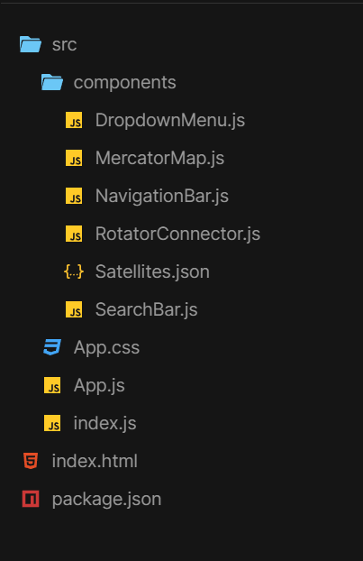
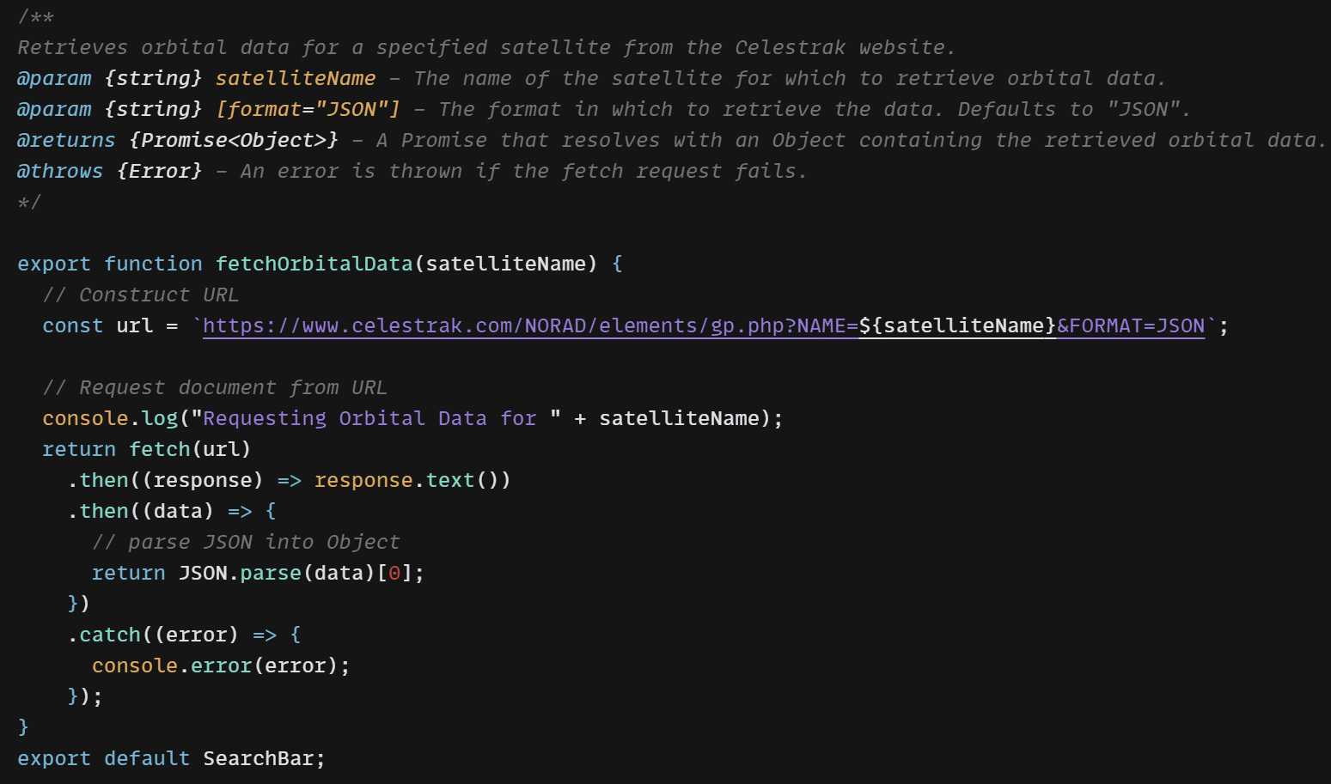
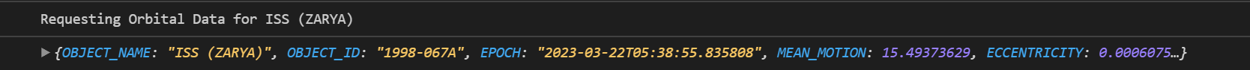
Demo

Slide 9
Execution Plan
Subsystem | Feb 27 | March 6 | March 20 | April 3 | April 17
Web App | UI Feature Finalization | Wifi Port/ MCU Connect | Search/OMM Retrieval | Interactive Map | UI Data Visualization
PSU/Motor | Finish Overall PSU Design | Finish PSU/Motor Driver Schematic |  | Perfboard and Test Design
MCU | MCU connects to Wifi |  | LCD displays output | Finish Kepelarian math | MCU output signal for motor control

Slide 10
Validation Plan
Test | Criteria | Method | Owner
Signal | SNR >= 30dB | Built-In Signal and Noise measurements in SDR Interface | All
RST | R5 S5 T9 | Request report from one-to-one interaction | All
Accuracy | +- 4% | Rotary Potentiometer Positioning Sensors | All
Tracking Speed | 2 deg/second | Rotary Potentiometer Positioning Sensors/ MCU timer | All
Motor Supply | 48 Watts minimum | Multimeter/ Ammeter | Michael R
MCU Supply | 1.8 Watts minimum | Multimeter/ Ammeter | Michael R
GPS Location | +- 20 meters | Actual position of known location vs GPS coordinates | Hunter B
MCU/Web App Communication | OMM/GPS/Position Request/Read/Write | Console Log Reports | Hunter B/ David S
Web App Functionality | SearchBar/Controls/Map | Jest Framework, Console Log Reports, Error Handling | David S

